Slide 1

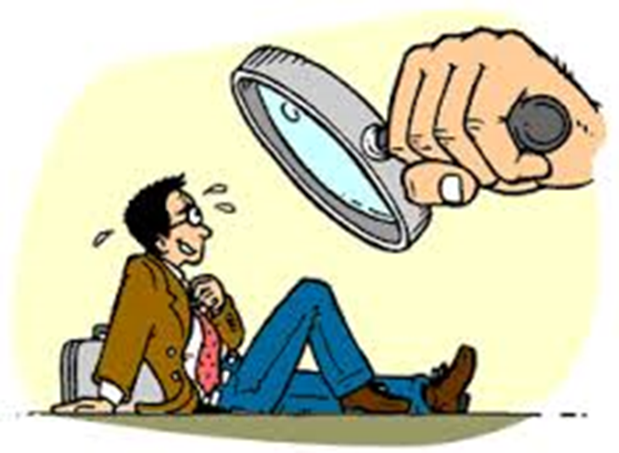
How to plan, write, and customize
a winning document

Slide 2

What experience are you offering?
When do you need one?
Why do you need one?
What will you accomplish with your cover letter?
How can you use your cover letter for networking?

Slide 3
A cover letter is a document that presents your job goals, education, and job history. The cover letter explains why you are capable of filling the job position you want.

Slide 4

Send an original letter
  Keep it short, specific, and to the point
  You CAN use several basic cover letter
  templates, customized for the particular position and company to which you are applying
State the job title
Explain why you want this job
  NOT to “make money”

Slide 5

Job applicants must send a cover letter _______ sending their resume.
A- before
B- when
C- after

Slide 6
Job applicants must send a cover letter _______ sending their resume.
A- before
B- when
C- after

Slide 7

Describe specific ways you will contribute
  Refer to, but don’t repeat, your resume
  Reflect your own self-confidence
Keep the content professional
Maintain a tone of warmth
State your follow-up plan

Slide 8
Proofread, revise, and edit…
…this is extremely important….

Slide 9
Q. A cover letter should be
clear and concise
friendly and funny
long and detailed

Slide 10
A cover letter should be
clear and concise
friendly and funny
long and detailed

Slide 11

Your Contact Information
The Date
Employer’s Name, Position, and Address
The Greeting
Introductory Paragraph
Body of the Letter
Summary Paragraph
Closing
Your Name and Signature

Slide 12

Street Address
City, State, Zip
Telephone Number
Current Date
Employer’s Name
Title
Department
Organization
Street Address
City, State, Zip
Dear Mr./Ms./ Dr./ Individual’s Name:

Slide 13

1309 E. 10th Street
Bloomington, IN 47405
October 15, 2020
Ms. Sandra Jones
ABZ Company
New York, New York
00055
Dear Ms. Jones

Slide 14

Limit paragraphs to two to five complete sentences
Use appropriate vocabulary
If this is a repeat contact type of letter:
  Give specific details of any previous correspondence or conversation.
  State appreciation for past consideration.
Supply your credentials.
List a specific job title.
Indicate your knowledge of the company.
Mention the name of a contact.

Slide 15
Q. Which date format is best for a cover letter?
A- October 9, 2020
B- 9/10/20
C- 10/9/20

Slide 16
Q. Which date format is best for a cover letter?
A- October 9, 2020
B- 9/10/20
C- 10/9/20

Slide 17

I am responding to your ad in Business Week for a position as an Accounting Consultant. My experience and education make me an excellent candidate for this position.

Slide 18

Q. Your name should be _______ of the letter.
A- at the top
B- in the middle
C- at the bottom

Slide 19

Elaborate on your resume
  Use real examples (mini-STARs)
  State applicable work/internship experiences
  List relevant coursework
  Stress your key assets as they relate to this specific job
Highlight applicable skill sets
  technical skills
  writing ability
  proficiency in languages
  job-applicable personal interests
Make reference to attachments

Slide 20
Q. Cover letters often begin with the applicant explaining how they
A- began their education
B-spend their free time
C- found out about the job

Slide 21
Q. Cover letters often begin with the applicant explaining how they
A- began their education
B-spend their free time
C- found out about the job

Slide 22

Limit paragraphs to two to five complete sentences
Use appropriate vocabulary
My career has been built in non-profit management, commercial banking, public finance, accounting, management, and human resources. My success has come from identifying, leveraging, and combining my skills and knowledge with my passion to achieve. I have consistently met, even exceeded, the expectations of my employers.

Slide 23
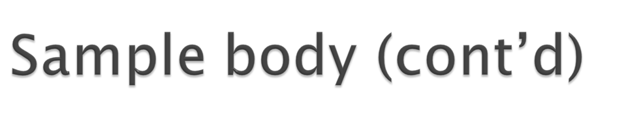
Limit paragraphs to two to five complete sentences
Use appropriate vocabulary
As noted on my resume, I am involved in many professional and community organizations. My leadership positions in these organizations, combined with my strong business background, show that I possess the skills needed to be a candidate for the Accounting Consultant position. I am outgoing, hardworking, and easy to get along with. I am willing to learn any new skills needed for this position.

Slide 24
Your cover letter should explain how much you will _______ the company.
A- benefit
B- charge
C- disrupt

Slide 25
Your cover letter should explain how much you will _______ the company.
A- benefit
B- charge
C- disrupt

Slide 26

You can use BULLET POINTS for emphasis within a paragraph
You can list qualifications mentioned in the job listing in BOLD print, then describe your corresponding skills or experiences
You can try a two-column approach
Employer’s Needs Your Skills

Slide 27

Ask for an interview
Indicate your next action
Appropriate closing line, such as:
Sincerely,
Truly yours,
Typed name
Enclosure:
cc: (indicates to whom a copy has been sent)

Slide 28
What must be included in a cover letter?
Recipient information
Return address
Date
All of the above

Slide 29
What must be included in a cover letter?
Recipient information
Return address
Date
All of the above

Slide 30

I would like to discuss this position with you in person. Please feel free to contact me with any questions you have. You may reach me at 812-855-5555 or jadoe@indiana.edu. I will follow up with you next week to check on the status of my application. Thank you very much for your consideration.
Sincerely,
Jane Doe
Enclosure: resume

Slide 31

Use powerful action verbs (See examples)
Search out appropriate self-descriptive adjectives (See examples)
Use a thesaurus to select precise words
What five key descriptive words will your letter convey?

Slide 32
The ___________ paragraph should create interest and explain why you are writing. It should state the type of position you are applying for.
Closing
Introduction
Body

Slide 33
The ___________ paragraph should create interest and explain why you are writing. It should state the type of position you are applying for.
Closing
Introduction
Body

Slide 34

Achieved
Administered
Attained
Built
Coached
Completed
Coordinated
Delivered
Demonstrated
Developed
Effected
Established
Expedited
Formulated
Generated
Headed
Implemented
Improved
Invented
Launched
Led
Maintained
Managed
Motivated
Negotiated
Organized
Originated
Planned
Presented
Proposed
Reinforced
Reorganized
Researched
Set up
Simplified
Solved
Tackled
Taught
Updated

Slide 35

Adaptable
Analytical
Assertive
Confident
Conscientious
Creative
Disciplined
Efficient
Energetic
Enterprising
Enthusiastic
Expressive
Extroverted
Ingenious
Innovative
Manager
Personable
Persuasive
Precise
Productive
Reliable
Responsible
Self-reliant
Self-starter
Skilled
Tactful
Team player
Technical

Slide 36

More than one page
Too many attachments
Errors in grammar or spelling
Too little information
Non-standard terminology
Notes:
“Hey sounds good, sign me up” doesn’t make it
The interviewer is a busy person, don’t overwhelm him/her with written material
Any mistakes probably send your application to the trash can
Anticipate questions your application will raise: why you want job, why you are relocating, commute to nearby communities
“I remain your humble servant” isn’t used in US language

Slide 37
Cover letters are generally _____ page at most in length.
Four
Three
Two
One

Slide 38
Cover letters are generally _____ page at most in length.
Four
Three
Two
One

Slide 39

Proofread the next day
No errors are allowed
Read the letter aloud
Seek advice from qualified sources such as career counselors, professors, business associates, relatives, and friends

Slide 40

Encourage communication
  Enclose a reply postcard
  Request an email reply
  Suggest dates and times for an interview
  Follow up with a phone call (Be careful not to annoy the recruiter)
Request an application form- Deliver it Personally
Advise the employer when you will call to schedule an interview
Show personal initiative, not obnoxious pushiness

Slide 41
What is a very important tip you should do before submitting your cover letter?
Spell Check
Make it all bold
None of these

Slide 42
What is a very important tip you should do before submitting your cover letter?
Spell Check
Make it all bold
None of these

